Slide 1

<number>

Slide 2
Computational approaches for the therapeutic target discovery to ame-liorate muscle wasting during aging and disease

Slide 3
There’s a computer representation of the microRNAs and their interaction that allows the identification of micro RNA for the treatment of Sarcopenia.
<number>

Slide 4
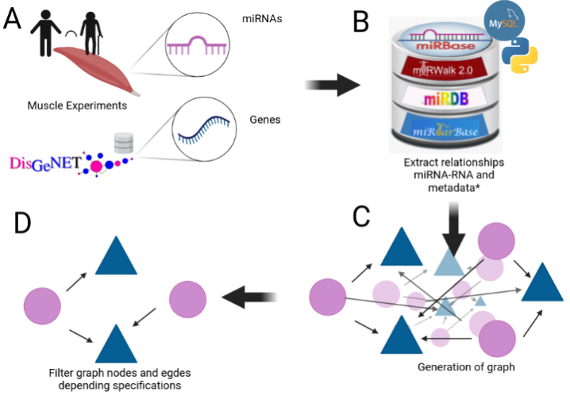
What does this project include

Slide 5
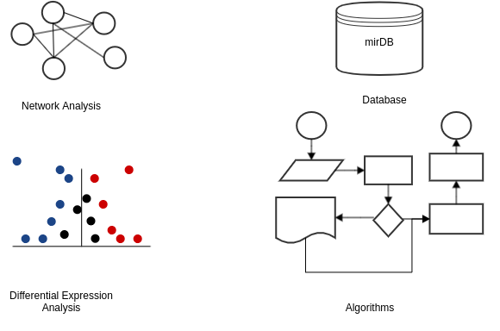
Key points

Slide 6
Network Analysis
<number>

Slide 7
MiRNAs Graphs/Networks
Chapter One: Why Networks?

Slide 8
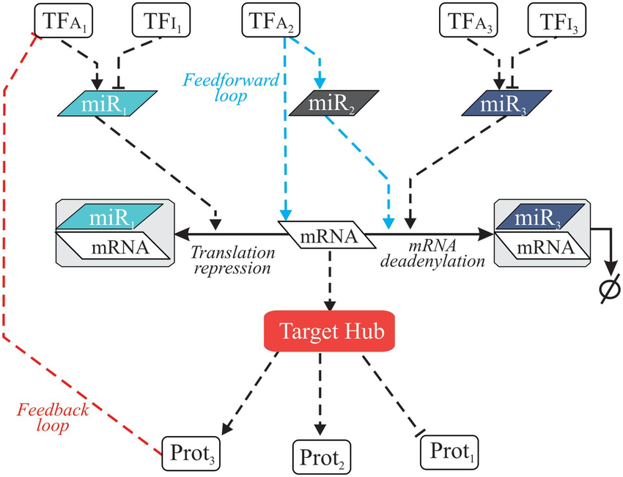
Regulatory Networks
Notes:
It is likely that miRNAs naturally build regulatory networks that control different cellular functions,
<number>

Slide 9
Regulatory Networks
Notes:
It is likely that miRNAs naturally build regulatory networks that control different cellular functions,
mathematical representation of a network and it describes the relationship between lines and points
<number>

Slide 10
MiRNAs Graphs/Networks
Chapter Two: What is already there

Slide 11
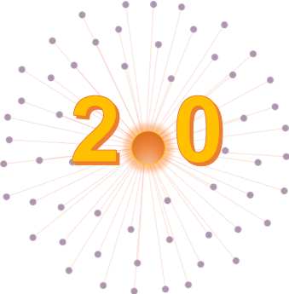
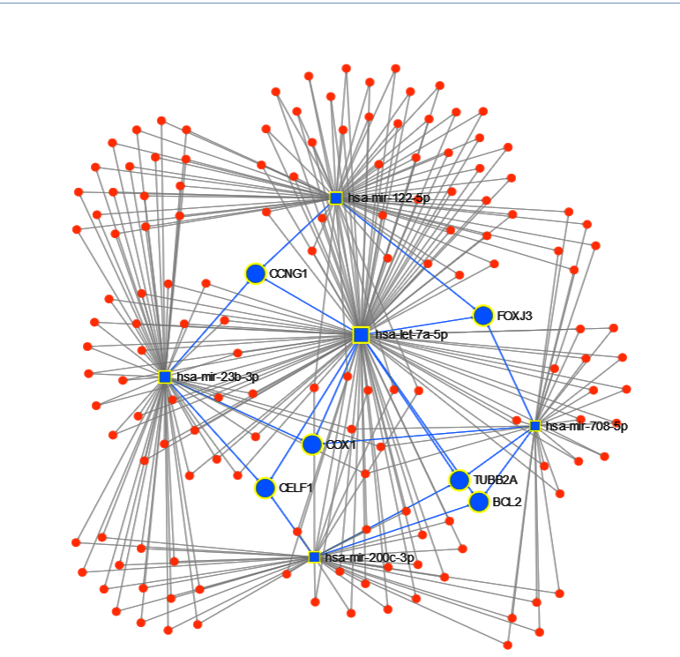
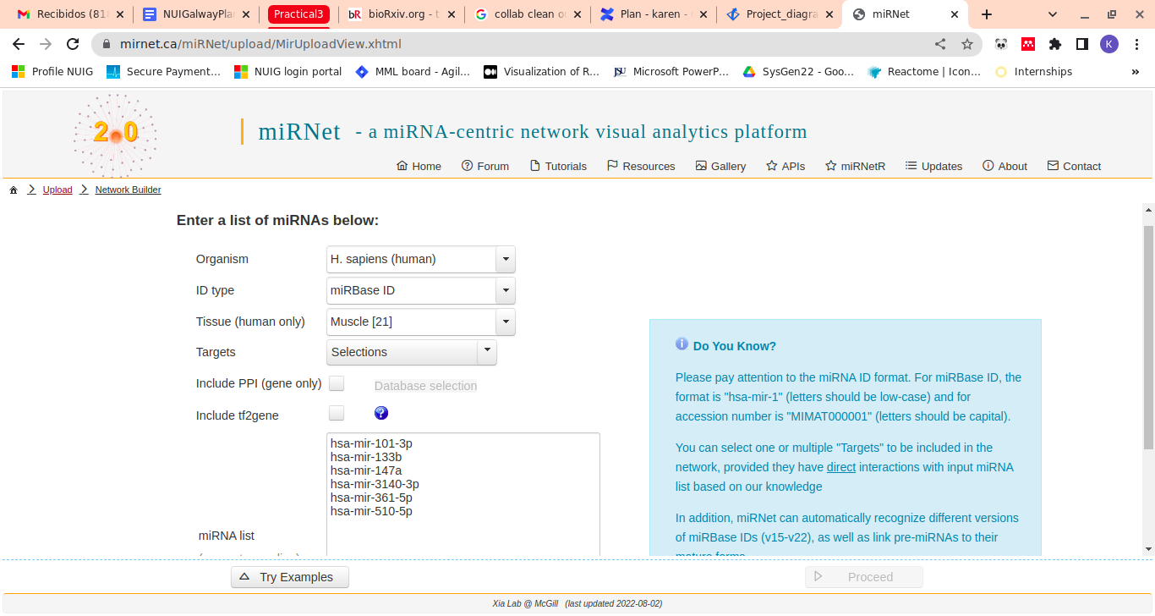
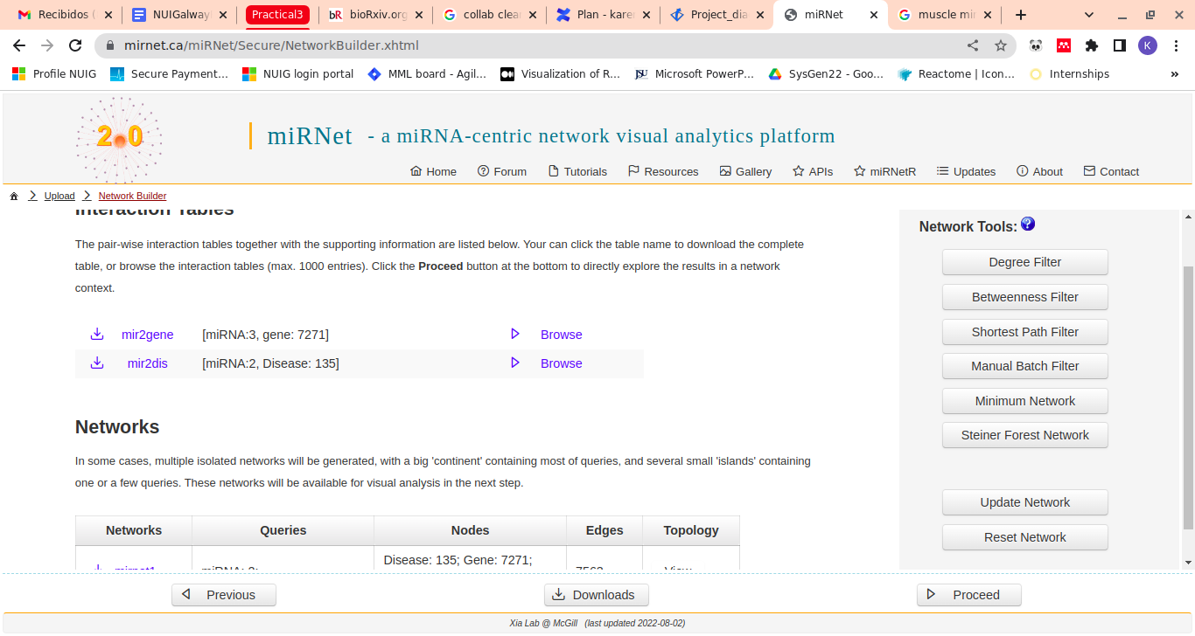
MirNet
miRNet - a miRNA-centric network visual analytics platform

Slide 12
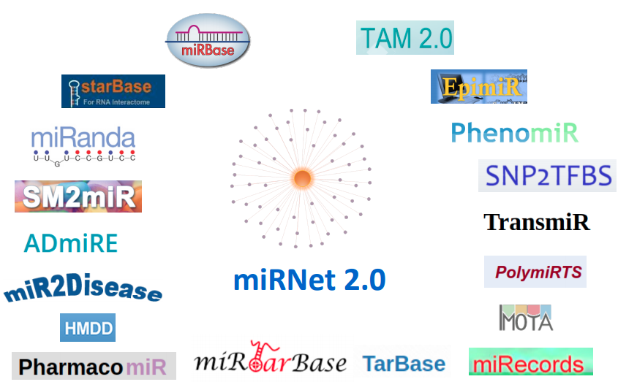
MiRNet

Slide 13

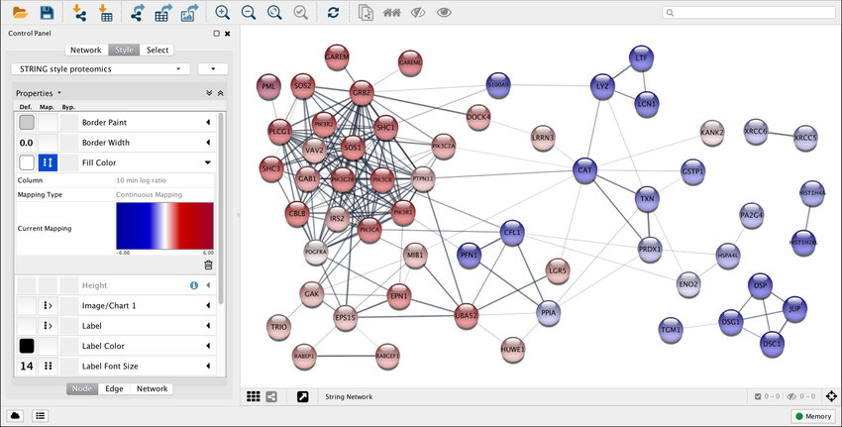
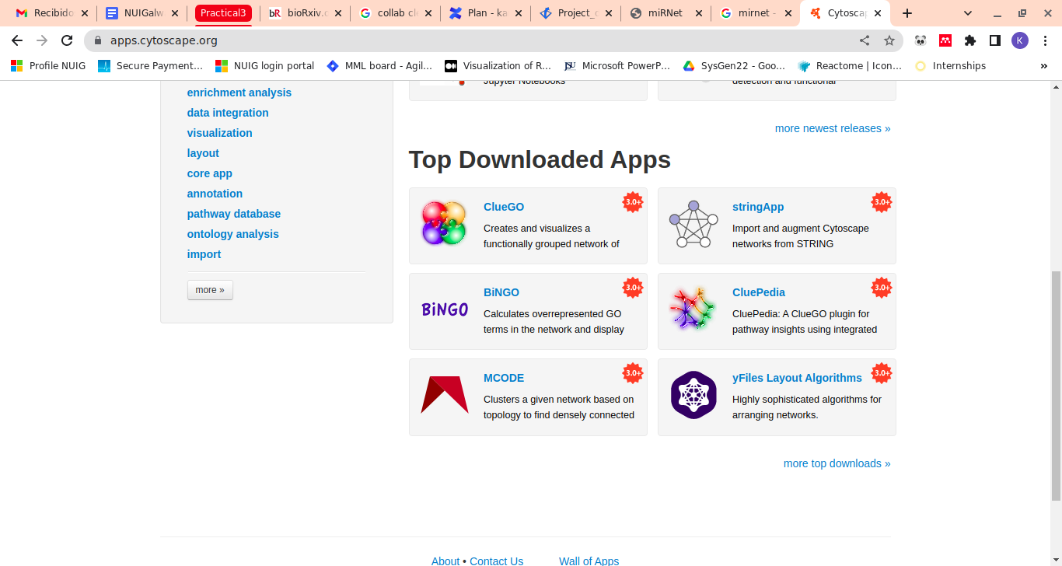
Cytoscape
+400 APPS

Slide 14

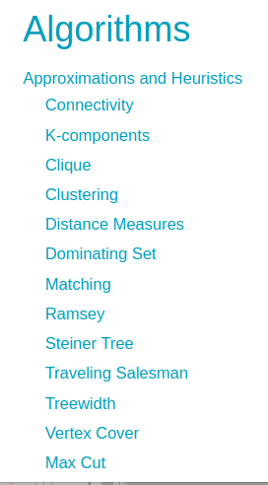
NetworkX

Slide 15
MiRNAs Graphs/Networks
Chapter Three: My plan

Slide 16
Objective
Given a set of microRNA, their targets and their Differential Expression, get a subset of microRNA with great “influence” on Sarcopenia.
The graph should be clear enough to create a “simple” model from it.

Slide 17
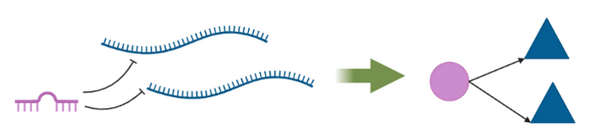
Methodolgy
Use Diff Exp Data to select Mirnas of interest
Use Cytoscape’s App Intact to select proteins of interest and build the graph scalfold
Use Databases to get the realtionship miRNA-Target
Build my own network from (2), adding the miRNA nodes from (1) and the edges stablished with (3)
Add value to each node and select the most relevants one (TBD)

Slide 18
MiRNAs Graphs/Networks
Chapter Four: Progress

Slide 19


Slide 20
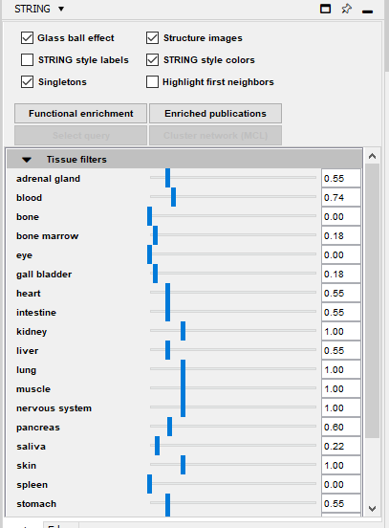
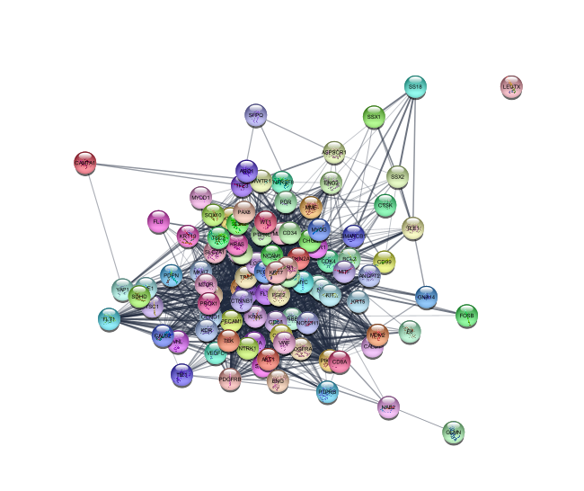
String
100 proteins
1634 edges

Slide 21
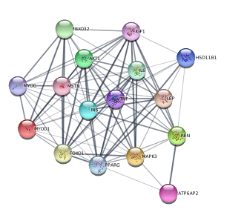
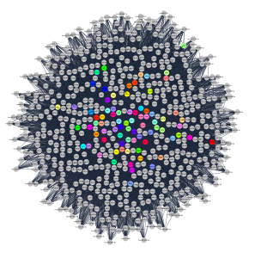
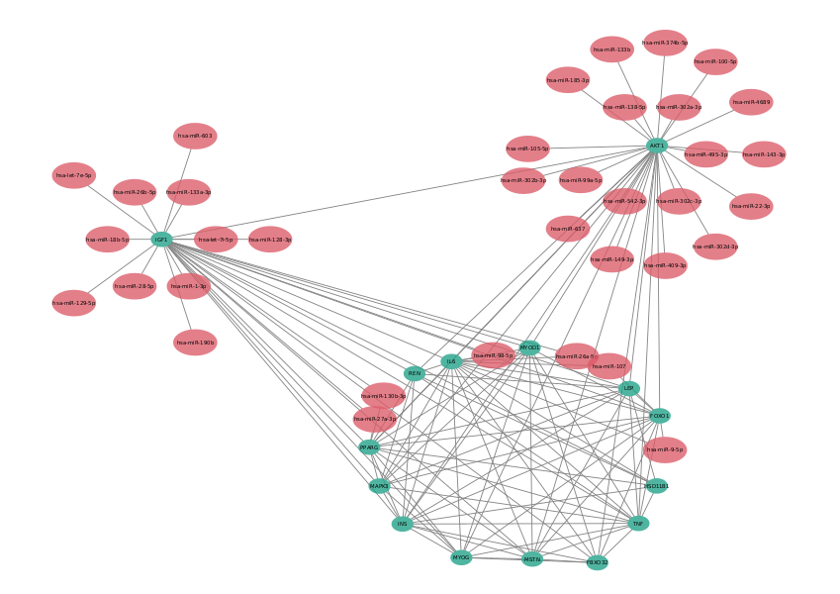

Slide 22
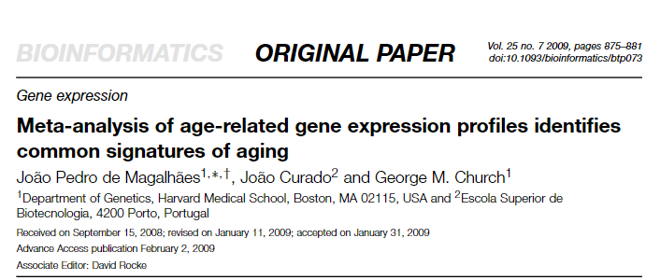
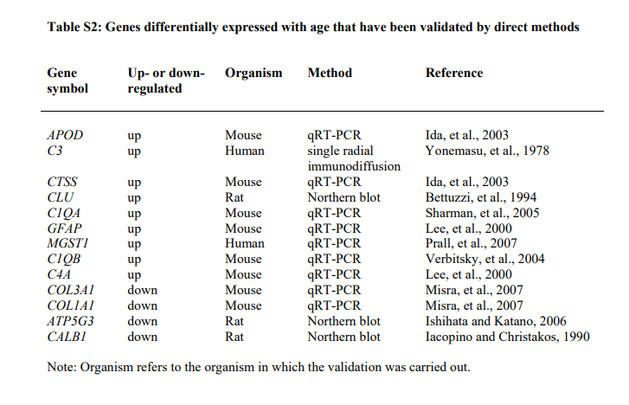
miRNA | Target selected genes | Seed | Occurrences
hsa-miR-10400-5p | 2 | AAGGCAG | 1
hsa-miR-1233-3p | 2 | AGAGAGG | 1
hsa-miR-3150a-3p | 2 | AGCCGCC | 1
hsa-miR-365a-5p | 3 | AGGGCUG | 1
hsa-miR-3714 | 3 | AGGGGGA | 1
hsa-miR-423-5p | 3 | CAGGGAG | 1
hsa-miR-4446-3p | 2 | CGGGGCU | 1
hsa-miR-4508 | 2 | CUGGGGA | 1
hsa-miR-4537 | 2 | GAGCCCU | 1
hsa-miR-4746-3p | 2 | GAGCCGA | 1
hsa-miR-6746-3p | 3 | GAGGGGC | 1
hsa-miR-6751-5p | 3 | GCGGUGC | 1
hsa-miR-6754-5p | 2 | GGGACUU | 1
hsa-miR-6763-5p | 4 | UGGGGAG | 2
hsa-miR-6794-5p | 3 | UGGGGGU | 1
hsa-miR-6856-5p | 3
hsa-miR-8089 | 3

Slide 23
Data Bases
<number>

Slide 24
MiRNAs DataBases
Chapter One: Why to create a Database

Slide 25
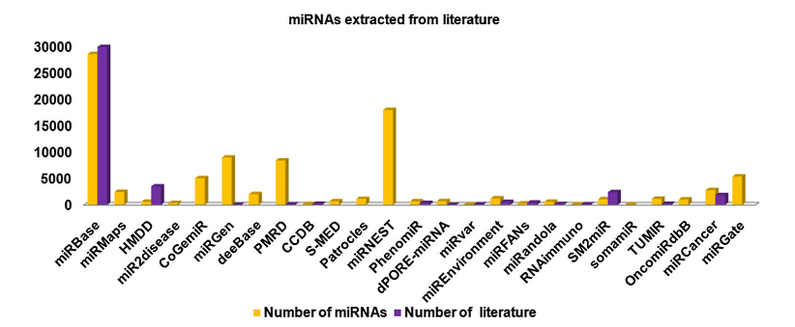
Number of miRNA in some DB

Slide 26



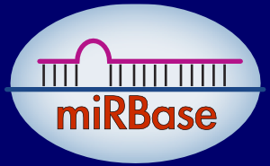


Characterization
Target mRNA
Expression Tissue
HMDD v3.2

Slide 27



My own local database
+
=
26
26
Notes:
<number>

Slide 28
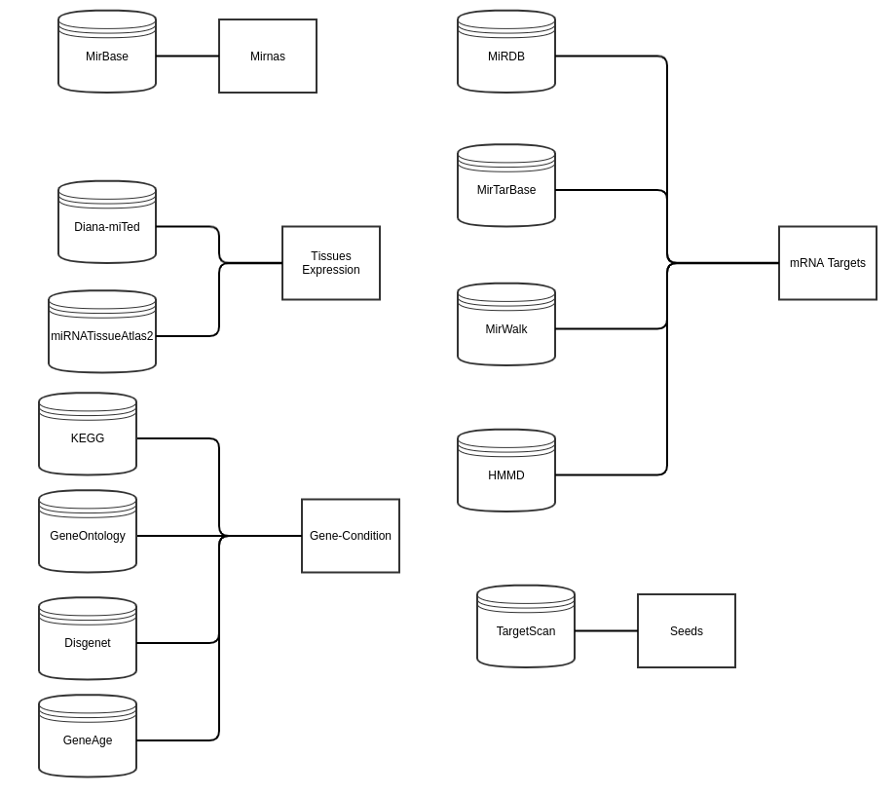

Slide 29
Integration
Mature mirna
Mirna_id Precursor Start End
Target
Mature mirna Target gene Source Probability
Genes
Gene Disease
Mirna
Id Name Sequence Species_id
<number>

Slide 30
Differential Expression
<number>

Slide 31
Differential Expression Analysis
Chapter One: Why DEA?

Slide 32
Differential Expression Analysis
Chapter Two: My data

Slide 33
My Experiments
Target | Type | N. Experiments
mRNA | RNASeq | 3
 | MicroArray | 4
miRNA | MicroArray | 1
 | RNASeq | 2
Proteomics | - | 1

Slide 34
RNA Seq
Experiment | n. S | Age range |  | Title | Library
GSE152558 | 5 | 41 | 85 | Ribosome profiling analysis of aging human skeletal muscle | TruSeq
GSE164471 | 53 | 34 | 80 | Skeletal Muscle Transcriptome in Healthy Aging | TruSeq
GSE157585 | 136 | 19 | >65 | Metformin Alters Skeletal Muscle Transcriptome Adaptations to Resistance Training in Older Adults | ?

Slide 35
Differential Expression Analysis
Chapter Three: Pipeline

Slide 36
Steps
Download files
fasterq-dump
Quality control
fastqc
Trimining
cutadapt
Aligment
kalisto
Analysis
DESeq2
Architecture: x86_64
CPU op-mode(s): 32-bit, 64-bit
CPU(s): 16
On-line CPU(s) list: 0-15
Thread(s) per core: 2
Core(s) per socket: 8
Socket(s): 1
Model name: Intel(R) Xeon(R) CPU D-1541 @ 2.10GHz
Totam RAM memory: 31G
Shared RAM: 939M
Swap memory : 15G

Slide 37
Differential Expression Analysis
Chapter Four: Progress

Slide 38
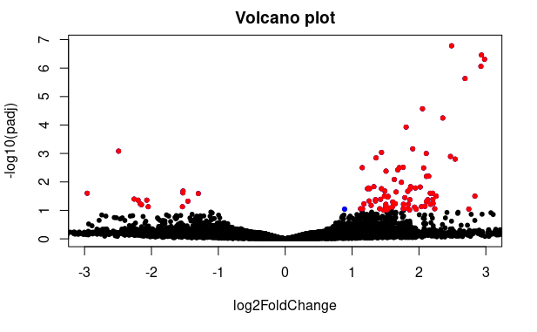
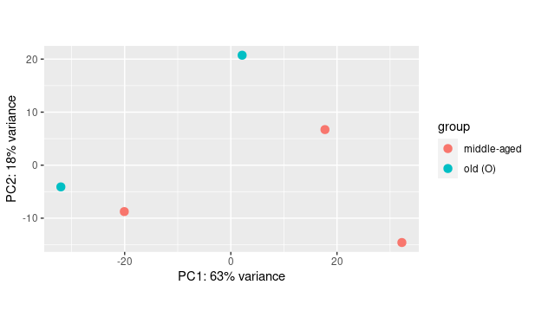

Slide 39
Algorithms
<number>

Slide 40
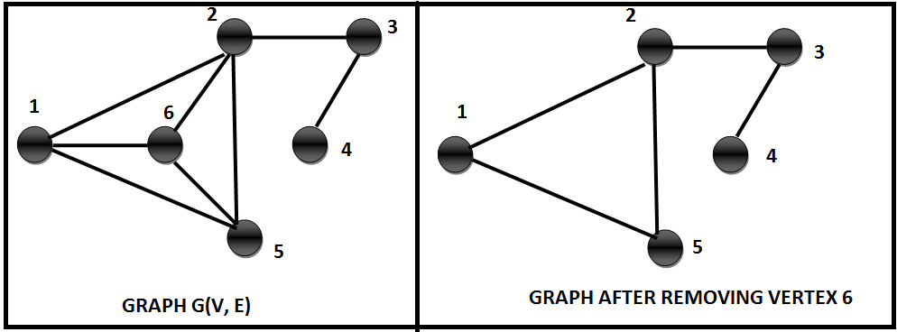

Graph operations
Similarity
Clusters
Centralities
<number>
Notes:
<number>

Slide 41
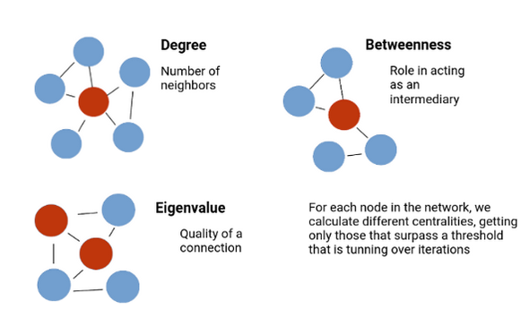
Some Centralities

Slide 42
Future plans
<number>

Slide 43
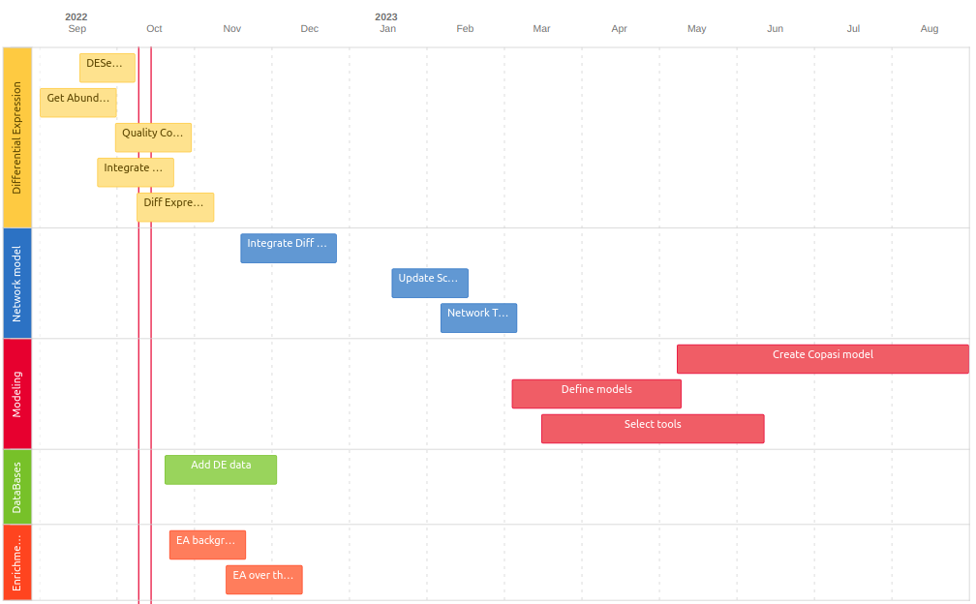

Slide 44
Thank you
<number>

